Slide 1
Developing an Automated Computational Genomics Pipeline for Breast Cancer Detection Using NGS
Abstract Id : 370
International Conference on
Recent Trends in Materials Science & Devices 2025
(ICRTMD-2025)
24-26 March, 2025
Dilip Sisodia^{a,b*}, Virendra Kumar Sharma^{b*}, Rohit Joshiª, Hemant Arya^{c}, and Tarun Kumar Bhatt^{c}
ªEngineering College, Ajmer, Rajasthan-305025, India
^{b}Bhagwant University, Ajmer, Rajasthan-305004, India
^{c}Department of Biotechnology, Central University of Rajasthan, Bandarsindri, Ajmer-305817, India

Slide 2

Introduction
Breast cancer is one of the most common and life-threatening diseases affecting millions of people worldwide. It occurs due to uncontrolled cell growth in the breast tissue, often caused by genetic mutations. According to the World Health Organization (WHO), in 2020, approximately 2.3 million new cases and 685,000 deaths were reported due to breast cancer.
In recent years, Next-Generation Sequencing (NGS) has emerged as a powerful technique to analyze genetic mutations linked to various diseases, including breast cancer. This project aims to develop an automated computational genomics Pipeline that can analyze NGS data and identify genetics mutations, in BRCA1 and BRCA2 genes.
2

Slide 3

Objective of the Study
Process NGS data from breast Cancer patients and healthy individuals.
Identify genetic mutations in BRCA1 and BRCA2 genes.
Analyze the correlation between mutations and breast cancer risk.
Using Machine learning models to classify patients based on genetics variations.
Support personalized medicine by enabling early detection and risk assessment.
3

Slide 4
Proposed Methodology
Data Acquisition
NGS data convert to FASTQ
Quality Control & Preprocessing FASTQ
Trimmomatic
Sequence Alignment
Align to genome Tools
Bowtie2
Variant Calling Identify SNP & Indels Tools SAMtools, BCFtools
Result & conclusion Analyze result, Future Work
Machine Learning Model
Train classifier
LR/RF
Feature Extraction mutation features
BRCA1/BRCA2
Variant Annotation Analyze mutation impact Tools
SnpEff

Slide 5
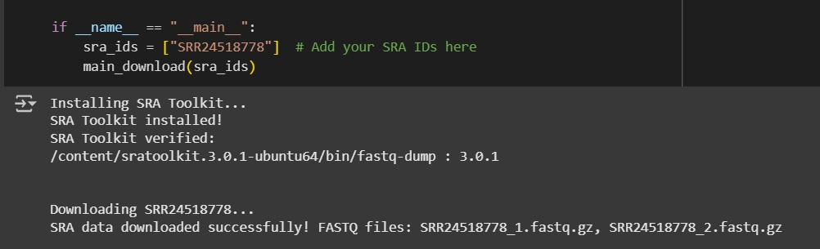
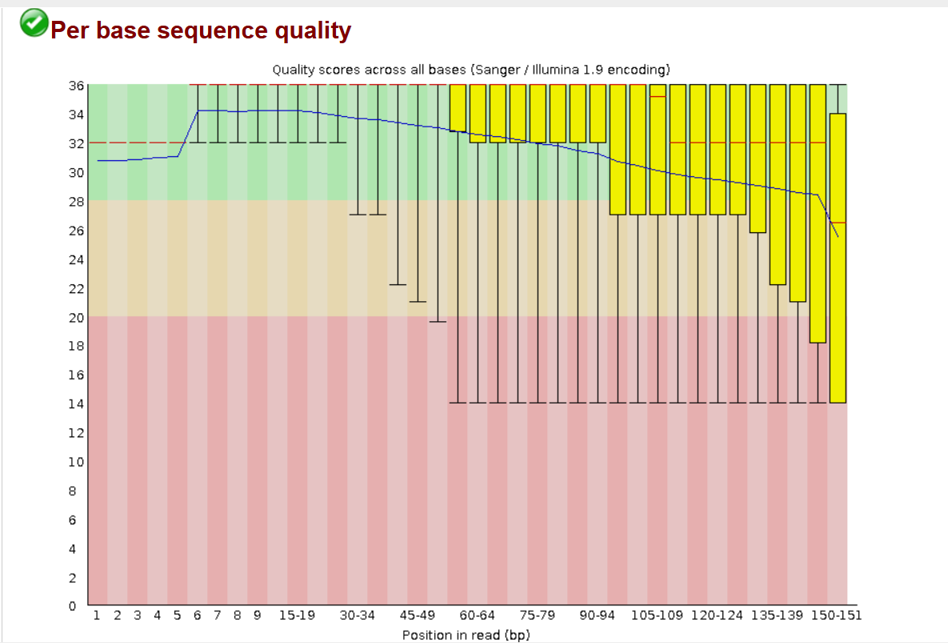
Preprocessing Steps
SRA Toolkit - Downloads sequencing data from NCBI SRA.
FASTQC - Checks base Sequence quality, Per Sequence Quality Scores
Trimmomatic – Removes low-quality reads and adapter sequences.
Figure 1: Downloading sequencing Data
Figure 2: Per base sequence quality
Key Outcome: Clean, high-quality data for accurate mutation detection
5

Slide 6
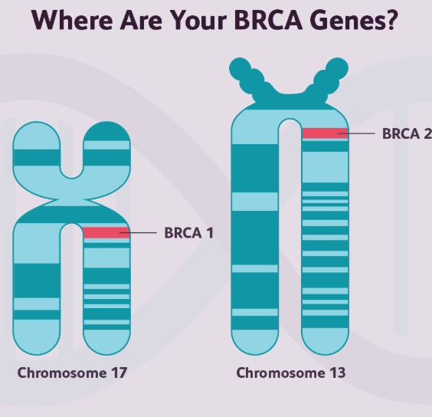
Mutation Detection & Annotation
Genomic Basis of BRCA1 & BRCA2:
BRCA1 gene is located on chromosome 17.
BRCA2 gene is located on chromosome 13.
Mutations in these genes significantly increase breast cancer risk.
Pipeline for Mutation Detection:
1. Bowtie2 – Aligns sequencing reads to the human genome. 2. SAMtools & BCFtools – Identifies genetic mutations. 3. SnpEff – Analyzes mutations and their impact.
Key Outcome: Efficient detection of genetic mutations in BRCA1 & BRCA2, aiding in early breast cancer diagnosis.
Figure.3: BRCA1 & BRCA2 Gene Locations

Slide 7
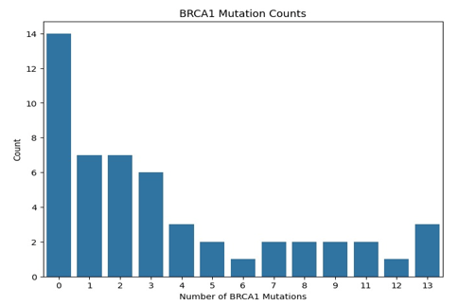
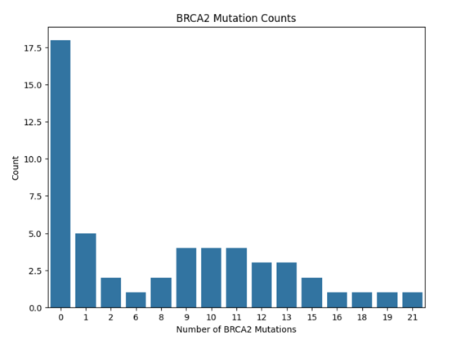
Machine Learning-Based classification
Feature Extraction from Genetic Variants:
Extracted key genetic mutation features (BRCA1, BRCA2, missense, synonymous, intron, splice site mutations).
Created a structured dataset for classification.
Algorithms Used:
1. Random Forest – Robust for feature importance analysis. 2. Logistic Regression – Useful for binary classification (Cancer vs. Non-Cancer)
Figure 4: BRCA1 Mutation Count
Figure 5: BRCA2 Mutation Count

Slide 8
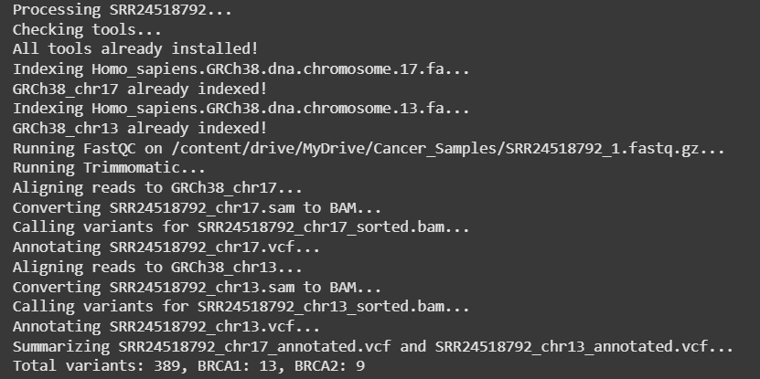
Result & Observations
Genomic Variant Analysis (SRR24518792 Sample) Total Variants Detected: 389 BRCA1 Variants (Chromosome 17): 13 BRCA2 Variants (Chromosome 13): 9
Pipeline Performance:
Efficient mutation detection in BRCA1 & BRCA2 genes.
Successfully aligned and annotated sequencing reads.
Variants identified provide insights into breast cancer susceptibility.
Key Takeaway: The automated pipeline effectively detects clinically relevant mutations, supporting genomic-based breast cancer diagnostics.
Figure 6: Variant Analysis for Sample SRR24518792

Slide 9
Conclusion & Future Scope
Conclusion:
Strong correlation found between BRCA1/BRCA2 mutations and breast cancer risk.
Developed an automated, efficient computational pipeline for genetic mutation detection.
Supports early diagnosis and personalized treatment strategies.
Future Scope:
Expanding dataset for higher accuracy.
Integrating deep learning models for improved mutation classification.
Exploring additional genetic markers beyond BRCA1/BRCA2.

Slide 10
References
Speiser, Dorothee, and Ulrich Bick. "Primary prevention and early detection of hereditary breast cancer." Breast Care 18, no. 6 (2023): 450-456.
A. C. Antoniou et al., "BRCA1 and BRCA2 mutations and breast cancer risk," The American Journal of Human Genetics, vol. 72, no. 5, pp. 1117-1130, 2003.
Parmigiani, Giovanni, Donald A. Berry, and Omar Aguilar. "Determining carrier probabilities for breast cancer–susceptibility genes BRCA1 and BRCA2." The American Journal of Human Genetics 62, no. 1 (1998): 145-158.
Antoniou, Antonis C., A. P. Cunningham, J. Peto, D. G. Evans, F. Lalloo, S. A. Narod, H. A. Risch et al. "The BOADICEA model of genetic susceptibility to breast and ovarian cancers: updates and extensions." British journal of cancer 98, no. 8 (2008): 1457-1466.
Mullis, K., & Faloona, F. (1987). "Specific synthesis of DNA in vitro via a polymerase-chain reaction." Methods in Enzymology, 155, 335-350.
Metzker, Michael L. "Sequencing technologies—the next generation." Nature reviews genetics 11, no. 1 (2010): 31-46
Cancer Genome Atlas Network. Comprehensive molecular portraits of human breast tumours. Nature, 2012, 490, 61–70.
Kleinbaum, D. G., & Klein, M. Logistic Regression: A Self-Learning Text. Springer, 2010.
Breiman, L. Random forests. Machine Learning, 2001, 45(1), 5–32.

Slide 11
Thank You!
Any Queries…..?

